Slide 1
We can read sight words.

Slide 2
he

Slide 3
was

Slide 4
for

Slide 5
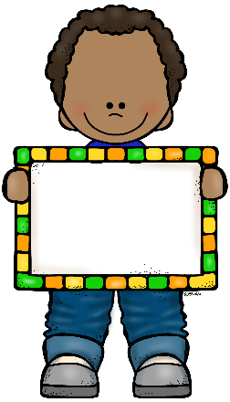
on

Slide 6
are

Slide 7
as

Slide 8
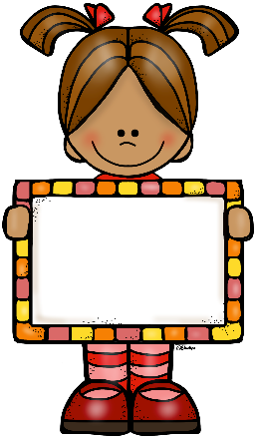
with

Slide 9
his

Slide 10
they

Slide 11
I

Slide 12
at

Slide 13
be

Slide 14
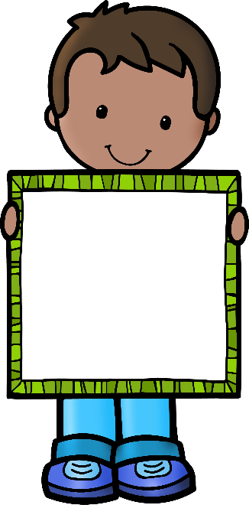
this

Slide 15
have

Slide 16
from

